Slide 1
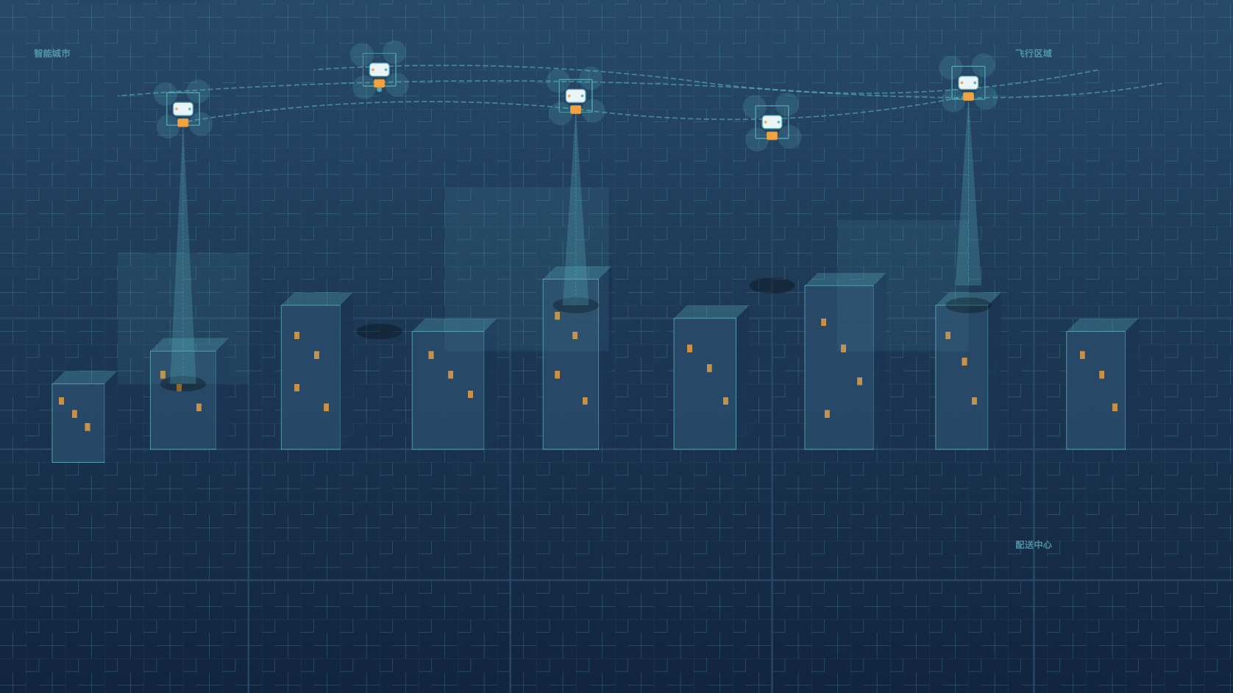

STRIPS-based Multi-Drone Delivery in a Horn-Shaped Map
Jing Yang, Yiming Li, Tianyu Qu

Slide 2
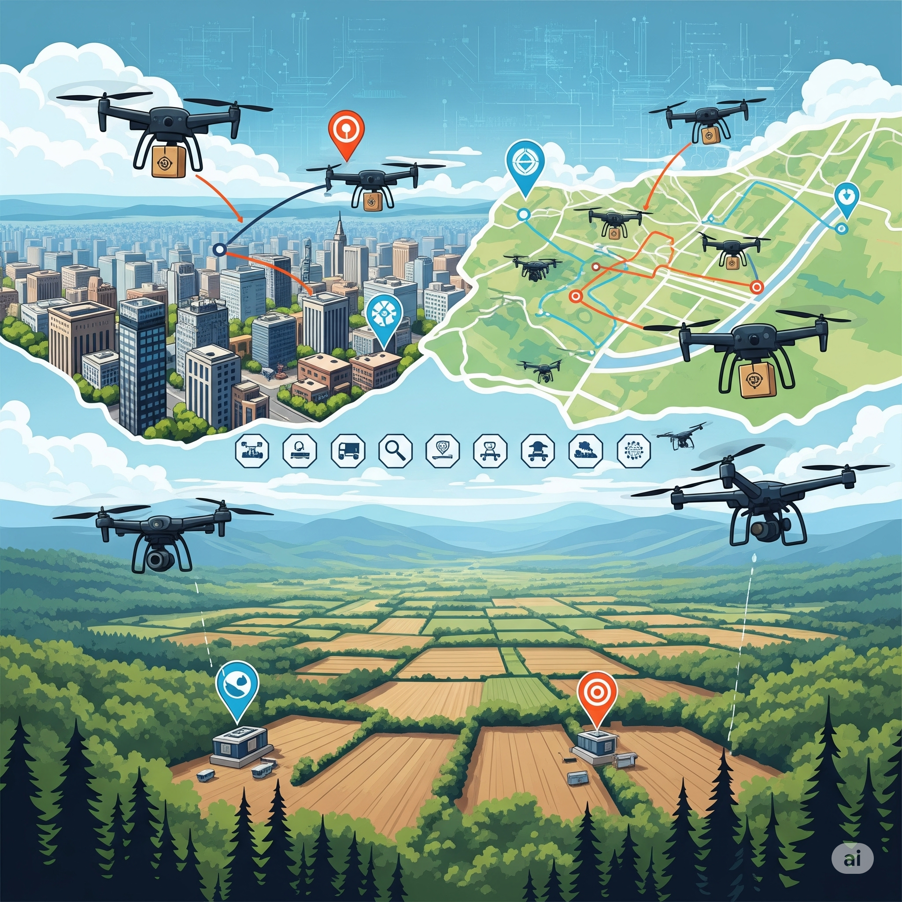
Motivation & Problem Statement
Intelligent System Engineering enables the creation of autonomous agents capable of complex decision-making and planning.
Drones, as intelligent agents, are deployed in real-world scenarios requiring advanced autonomy and adaptability.
Efficient path planning
Multi-agent coordination
Task allocation
Integrating AI planning techniques, such as STRIPS, with real-time simulation and control is a key challenge
Logistics & Delivery
Search & Rescue
Agriculture
Surveillance

Slide 3
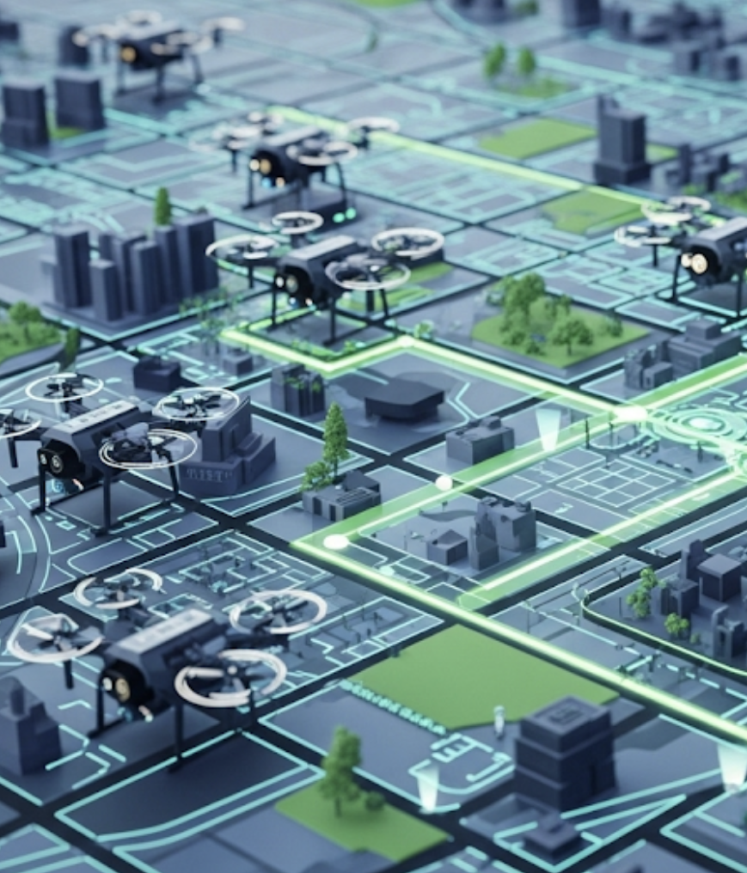
Project Overview
STRIPS based Autonomous Path Planning: Drones can compute and follow optimal paths while avoiding obstacles.
Multi-Agent Coordination Framework:
Support for multiple drones working together to accomplish complex tasks.
Real-Time Simulation & Visualization:
The system responds dynamically to changes in the environment or mission objectives.
Extensible research platform for AI planning :
Build an open-source platform for future development using LLM based planning.

Slide 4
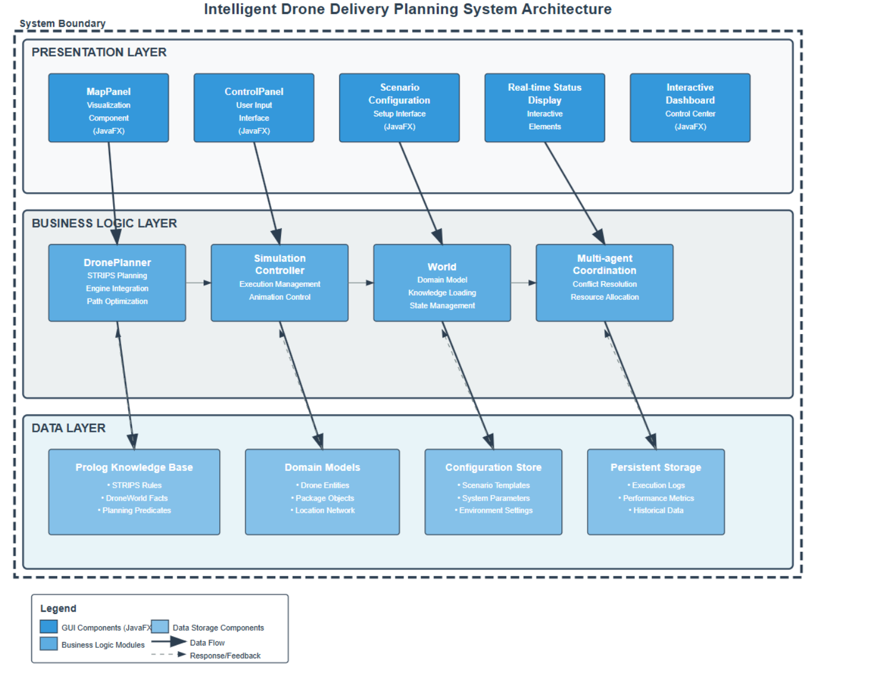
System Architecture
Layered Architecture
Knowledge Base layer
with Prolog modules (planning logic and facts),
Application Logic layer
in Kotlin/Java (simulation control)
Presentation layer
in JavaFX (GUI).
Hybrid Prolog–Kotlin Integration
Prolog | Kotlin
declarative planning | imperative execution

Slide 5
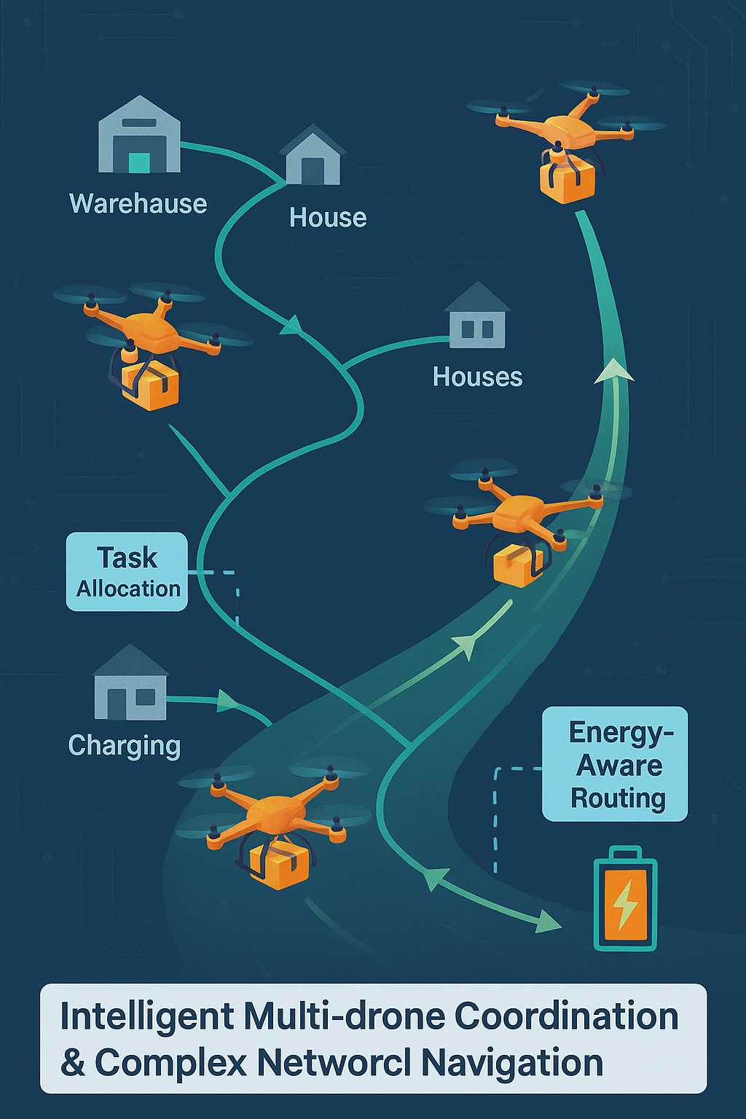
Multi-Drone Coordination Horn-Shaped Map
Multi-Agent Coordination: The planner and framework support multiple drones operating simultaneously in a shared network. Conflict Avoidance & Task Allocation
Horn-Shaped Map Topology: A custom complex map graph (shaped like a horn) models a realistic urban delivery network with branching paths and varied distances.
Energy-Aware Routing: Coordination includes managing battery constraints – drones may need to plan recharge stops route. The system ensures no drone runs out of energy mid-mission by incorporating recharge actions and energy checks in planning.
Notes:
A global coordination layer allocates tasks and resolves conflicts, while each drone has local planning for its route.
Conflict Avoidance: Temporal-spatial analysis prevents two drones from occupying the same location or route segment at the same time. Task Allocation: Packages are assigned to drones based on criteria like proximity, energy level, and load, ensuring balanced workload and efficiency.
Multiple warehouses, houses, and charging stations are interconnected in a horn-like layout, requiring drones to plan around a complex network structure (not just a simple grid)

